Slide 1

Installing Spinners

Slide 2
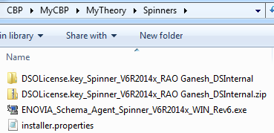
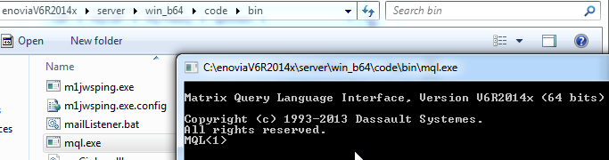
Prerequisites
The Installables required are displayed alongside:
an Installable exe
a License Key
MQL from your server directory must be launched and confirmed to work fine

Slide 3
The END

